Slide 1

FINANCIAL AID INFORMATION

Slide 2
AGENDA
2024-25 School Year
College Costs
What?
How?
When
What?
Free Application Federal Student Aid (FAFSA) – Big Changes
  NYS TAP Application
  Others – depends on school
Strategies/Tools

Slide 3




What Is Cost of Attendance (COA)?
Tuition and fees
Housing and food
Books, course materials, and supplies
Transportation
Miscellaneous and personal

Slide 4
Cost of Attendance (COA)
Typical Costs by Type of College | Private College | SUNY Public | Community College
Tuition and Fees | $40,000 | $8,500 | $6,000
Living Expenses Housing and Food | $14,000 | $14,000 | ????
Books/Course Materials/Supplies | $1,500 | $1,500 | $1,500
Transportation | $1,000 | $1,000 | $2,000
Personal Expenses | $1,500 | $1,500 | $1,500
Total | $58,000 | $26,500 | $11,000

Slide 5
What Is Student Aid Index (SAI)From FAFSA Results
Measurement of family’s ability to pay for college
SAI is new terminology in 24-25
The name replaces Expected Family Contribution (EFC) used in prior years

Slide 6

Student Aid Index (SAI)
Index number that the financial aid office uses to determine aid eligibility
Stays the same regardless of college choice
In some cases, students of highest need, could be negative number

Slide 7
What Is Financial Need?
Cost of attendance (COA) – Student Aid Index (SAI) = Financial need

Slide 8
Financial Need Examples
Cost of Attendance | $40,000
- SAI | $15,000
= Need | $25,000
Cost of Attendance | $65,000
- SAI | $15,000
= Need | $50,000

Slide 9
Sources of Financial Aid
Federal – Pell Grant, SEOG Grant, Teach Grant, Work-Study, Student Loans, Parent Loans
State - New York Grant (TAP) for New York residents attending college in NY State, Excelsior.
College you attend – Scholarships, work, loans
Private/Outside Sources – Scholarships, loans, tax credits, Veterans Benefits

Slide 10
Types of Financial Aid
Scholarships
Grants
Loans
Work-Study Employment
Self-Help Aid
Gift Aid

Slide 11
GRANTS
FEDERAL
STATE
PELL Grant
  Derived from FAFSA
  $0 to $7395 (2023-24)
SEOG Grant
TEACH Grant
TAP – any NY college
  NY Net Taxable Income below $80,800
  Excelsior – SUNY 2 year or 4 year college – Income $125,000 or below

Slide 12
Scholarships
Your College
  Review Website for merit, need, application
High School
Civic Groups or Businesses
Places of Employment
Free Internet Searches
  Example:
  www.fastweb.com
  www.finaid.org

Slide 13
Federal Direct Student Loan
Subsidized – 5.5% Interest rate (in 2023-24).
  Based on need (COA – SAI – other aid = Financial need)
  Federal government pays interest while student in school
  Freshman may borrow up to $3,500
Unsubsidized – 5.5% Interest rate (in 2023-24).
  Not based on need
  Student is responsible for interest while in school
  Freshman may borrow up to $5,500 minus any subsidized loan money (ideally - $3,500 subsidized and $2,000 unsubsidized)
Repayment begins 6 months after graduation

Slide 14
Parent Loan for Undergraduate Students (PLUS)
  Federal Loan in parent name
  Credit Check – No Adverse Credit
  8.05% interest rate (2023-24)
  Interest accrues at disbursement
  Payments right away
  Limits
    Up to COA minus other aid.

Slide 15
Work Opportunities
Federal Work Study Program (FWS)
  Need Based
  Limited hours
  Usually minimum wage
  Helps with personal expenses
  Each college has own process; jobs usually on campus or in community service.

Slide 16
HOW TO APPLY FOR FINANCIAL AID
Complete Federal Process – start at studentaid.gov
  FAFSA
Complete NY STATE Process – start at hesc.ny.gov
  TAP APPLICATION
Complete process and any requirements at each college – check their websites – talk with Admissions/Financial Aid Staff
Search Private Scholarships
Follow up – later applications, documents, communication

Slide 17
How to Apply for Federal Financial Aid
Go to studentaid.gov for complete information on federal financial aid programs and applying
Request an FSA ID for the student and parent of record (Anytime Now) – takes up to 3 days to authenticate
Complete FAFSA online: sometime in December of 2023 if applying for 24-25

Slide 18

FAFSA 24-25
https://studentaid.gov/aid-estimator/

Slide 19
FAFSA Changes in 24-25
Student begins FAFSA after signing in with their FSA ID.
After completing their part – they invite parent(s) via email in form – to be contributor on the FAFSA.
Parent completes their part and submits form
Student and Parent, on FAFSA, will have to consent for Direct Data Exchange with IRS for Federal Tax Information to load into FAFSA.
Sometimes, both Parents will need to be contributors if they are married and file separate taxes.
For Separations and Divorces – the parent of record whose information would go on FAFSA is the Parent who provided the most financial support over the last 12 months.
Family Size – uses IRS definition of dependents on tax return

Slide 20
How To Apply
Complete TAP Online
https://www.hesc.ny.gov
  After completing FAFSA
  Establish student HESC PIN.
  Student and Parent e-sign at end of application.
  Must re-apply each academic year.

Slide 21
Apply for Excelsior (if available)
If SUNY or community college in NY State
  To be notified when (if) the application becomes available
  Sign up for the HESC alert at www.hesc.ny.gov/excelsior
  Same application site as TAP
  Application will not be available until some time in 2024

Slide 22
Excelsior Scholarship
Began Fall 2017
How it works:
  Award equals max of SUNY Tuition minus any amounts received for TAP, Pell or other scholarships
  Earn 30 Credits Per Year
  Live and work in NY after college
  $125,00 was income limit in 2023-24

Slide 23
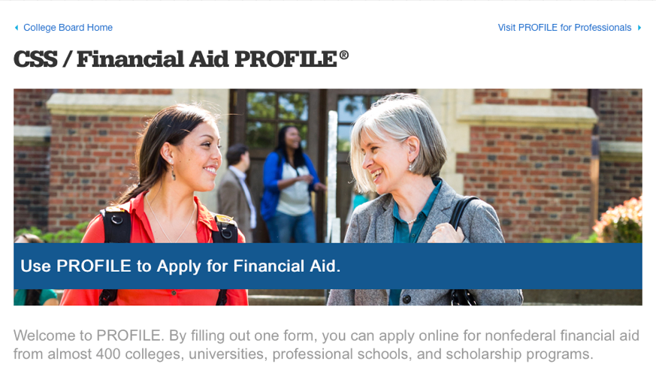
CSS/ Financial Aid PROFILE
(For Some Competitive Private Colleges)
The PROFILE is a form that allows students to complete one form and apply online for non-federal financial aid from almost 400 colleges, universities, professional schools, and scholarship programs. Check with college – usually just highly competitive private colleges.
https://cssprofile.collegeboard.org

Slide 24
When To Apply for
2024-25
FSA ID – Now or Near Future
Scholarship Searches – Now/Ongoing
FAFSA – After it is Released in December 2023
TAP – After the FAFSA.
Other Forms??
  Excelsior for SUNY; CSS Profile some privates
  Some schools may have separate form for their own scholarships, etc…

Slide 25
Watch for Results & Communicate with Financial Aid Office
  FAFSA Results will be available in 3-5 days – to student and colleges listed
  Schools May Ask for Follow up Forms or Documents – To Verify Reported Information.
  Each Schools timing will vary.
  Eventually Receive Financial Aid Offer Letters from Accepted Schools.

Slide 26
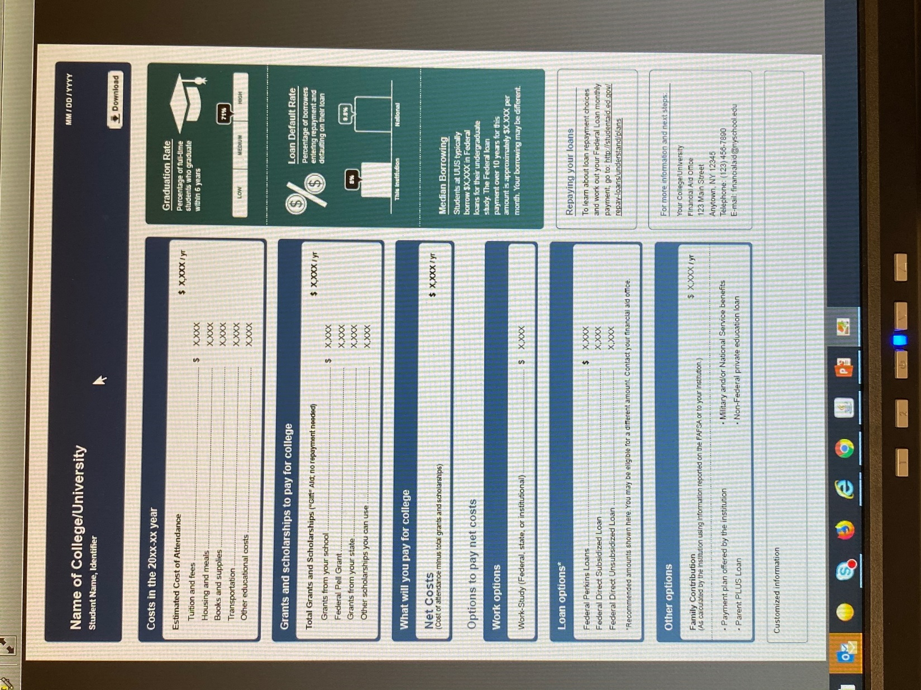

Slide 27
Strategies - Preparation
Keep Organized – be ready to follow up
  remember FSA ID; folder for documents; etc…
Meet Deadlines!
Parent/Student Communication
  E-mail checking
  FERPA- Student has to grant access for parent to interact with school
Compare – Make Charts?
  Required forms and dates for each school
Payment Plan as opposed to Alternative Financing or Parent Loan.
Savings – 529 plans
Reduce costs when you can– books, tech, etc…

Slide 28
Special Circumstances
Conditions exist that cannot be documented with the FAFSA
Send written explanation and documentation to your college’s financial aid office after initial FAFSA results are done
College will review and request additional information if necessary
Decisions are final and cannot be appealed to U.S. Department of Education

Slide 29

Special Circumstances
Unusual uncovered medical/dental expenses
Secondary school tuition
Extraordinary dependent care
Parent or spouse death
Student cannot obtain parental information
Loss of employment or income
Divorce

Slide 30
Questions
Jerome St. Croix, Director, Financial Aid
Monroe Community College
jstcroix@monroecc.edu

